Slide 1
Discover i-View IP Survilliance Solutions
Continues to drive the new technologies in the video surveillance market and helps organizations protect and secure their people, assets, facilities, and peace of mind is our aim. From scalable HD video monitoring and recording to integrate with NVR, CMS, FoS (Failover Server), IP Cameras, IVA (Intelligent Video Analytics) Server, ALPR (Auto License Plate Recognition), Face Recognition, Network Audio System, and Parking Guidance System. i-View unveils new technology at an unrivaled stable to provide organizations of all sizes with the ability to deploy surveillance systems that can scale and adapt to your unique security needs as your environment evolves.

Slide 2
What are i-View Video Surveillance Solutions?

Slide 3
VehRecog® Vehicle recognition
Our Vehicle Recognition Can Do More…
i-View specializes in car recognition and analytics for video security systems. Our VehRecog® vehicle’s recognition engine with state-of-the-art image processing, computer vision, neural network, and machine learning algorithms, the engine provides ALPR, AMCR, ACNR, AWNR, and AUTO UIC multi-car recognition modules for multiple application. Today, the systems are giving positive results for numerous industries across a wide range of field applications.

Slide 4
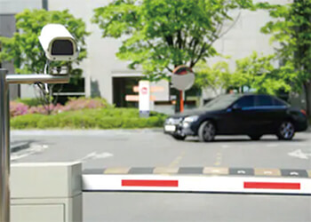
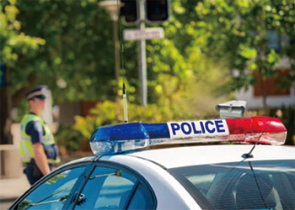
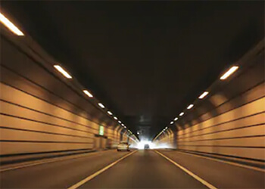
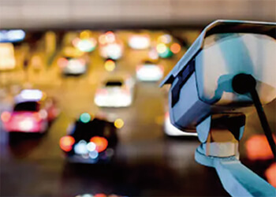
VehRecog® ALPR (Auto License Plate Recognition)
What i-View ALPR can do?

Slide 5
PlateFinder® Mobile ALPR System
Why choose PlateFinder® Mobile ALPR Enforcement System?
According to statistics from the International Association Chiefs of Police, up to 70% of significant crimes relate to theft of vehicles or their use in illegal activities, stolen cars are not just a loss of money only, and it also triggers other crimes. The above crimes let communities and schools pose serious threats, and it needs to improve effectively. The fundamental analysis and statistics show that the ALPR system is particularly useful in assisting law enforcement agencies in finding stolen vehicles and missing persons and investigating robberies and kidnappings. Install the Mobile ALPR system on police cars to detect stolen cars around the clock will be a practical and wise choice while does not increase the burden of the extra police force.

Slide 6
Why Need Mobile ALPR System?
The PlateFinder® ALPR system is a powerful weapon against illegal vehicles:
$√$ The police cars will pass through how many cars, motorcycles, trucks parked on the side of the road or driving on the road every day? The license plate camera can capture 1800 frames per minute via the ALPR system that means there is a massive quantity of license plate numbers matched with the list of illegal vehicles through the mobile ALPR system. With the help of the ALPR system, police officers can quickly and massively identify criminal cars. Using the mobile ALPR system against illegal vehicles is the same as increasing a group of police forces to assist law enforcement agencies in working together to crack down on criminal vehicles, promote justice, and maintain social security.

Slide 7
Why Need Mobile ALPR System?
Not only searches for illegal vehicles but also assists in finding missing persons and wanted :
$√$ PlateFinder® mobile ALPR system supports face recognition capability when a patrol officer checks a suspicious vehicle, and the system will automatically recognize the face of the on-site personnel. Therefore, it can detect the abducted, missing persons, wanted criminals, and send an emergency alarm to remind the police on-site when lists are recognized. The function will let the police officer has more time to deal with it.

Slide 8
Why Need Mobile ALPR System?
Mobile ALPR system is an effective tool for deterring crime:
$√$ Most crimes and terrorist activities on a global scale involve vehicles. Therefore, in geographic areas where vehicle-related crimes are increasing rapidly, how to effectively identify a specific car from a large number of vehicles is a crucial link in preventing gang-related crimes such as kidnapping, stolen cars, and drug trafficking.

Slide 9
Why Need Mobile ALPR System?
Real-time data assist law enforcement officers in responding quickly :
$√$ PlateFinder® Mobile ALPR system actively and continuously recognizes the license plate number of revoked, stolen, and other illegal vehicles. When a matching license plate number list appears, it will pop up an instant alert on the screen automatically to notify the patrol police while transmits the detailed data of the suspicious vehicle to the control center takes appropriate.

Slide 10
What can help the Law Enforcement Agencies with the PlateFinder® mobile ALPR system?
PlateFinder® Mobile ANPR is the innovative solution for increasing police cars’ effectiveness, prevent crime, helping frontline police officers to work faster and better, also can help law enforcement agencies to execute :
$√$ Locate the stolen vehicles
$√$Found tax-owed vehicles
$√$Assistance in finding missing persons
$√$Real-time warning wanted criminals
$√$Search for evidence of illegal parking vehicles

Slide 11
What can help the Law Enforcement Agencies with the PlateFinder® mobile ALPR system?
In the meantime, with the help of the system to improve can do :
$√$ Increasing operational efficiencies
$√$ Helping police to act faster
$√$ Fighting police corruption
$√$ Reducing paperwork

Slide 12
PlateFinder® System Advantage
Wide Range
Recognition range covers ahead moving cars and parked cars on the road’s side.
Dual Cameras*
Installed 2 cameras to get 2X recognition performance.
≥120 Km/H
The maximum relative speed of recognition.
N:N Face Recognition*
Multiple face recognition simultaneously.

Slide 13
PlateFinder® System Advantage
98% Accuracy
Accuracy of license plate recognition.
120+
The number of supported countries and zones.
IR LED
Capture clear images at nighttime via High-brightness infrared LED assist.
Alarm Notification
Automatic notify when the event is triggered.

Slide 14
PlateFinder® System Advantage
Export/Import Data
Export the consolidated event report, and allow
the import and export of list data..
4G Mobility*
Synchronizes database via 4G wireless transmission.
GPS*
Accurately grasp the event location through GPS.
Embedded O.S.
Install embedded operation system into SSD storage.

Slide 15
PlateFinder® System Advantage
S.M.A.R.T.
Supports prevent warning function of hard disk damage (S.M.A.R.T.).
Watchdog Timer
Built-in watchdog timer avoids system crash.
* is optional function.

Slide 16
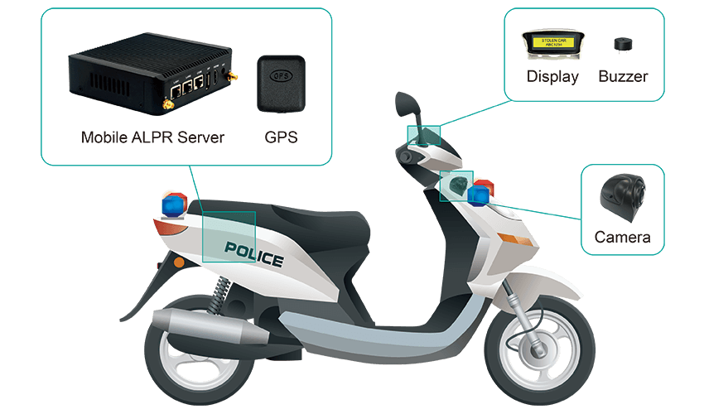
How does the PlateFinder® mobile ALPR system work?
System Installation (Installs on the police motorcycle)

Slide 17
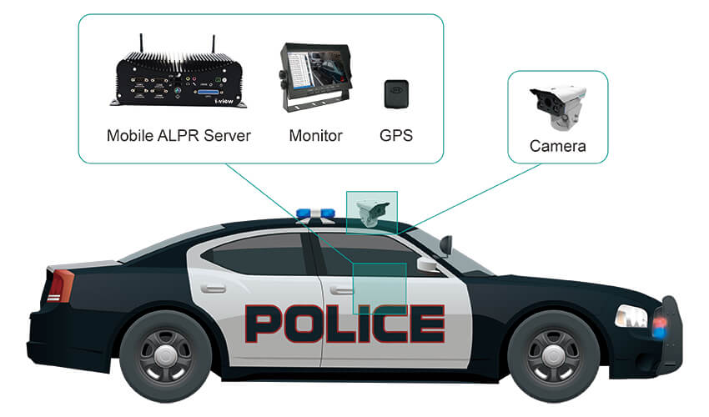
How does the PlateFinder® mobile ALPR system work?
System Installation (Installs on the police car)

Slide 18
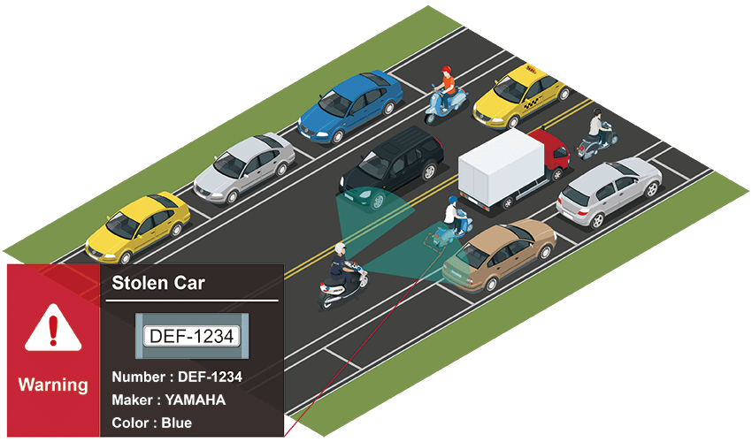
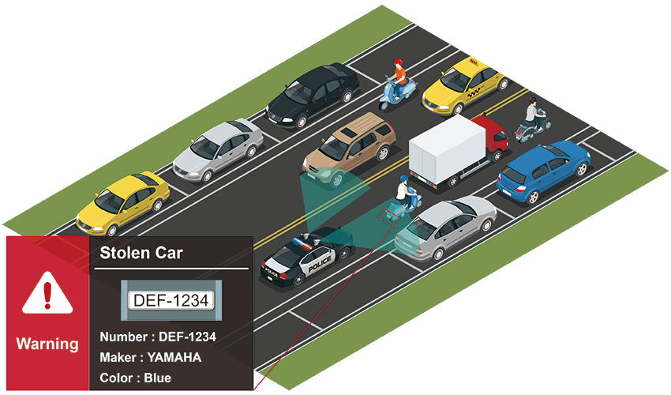
Application on urban traffic roads
It is suitable for slower urban traffic and parking vehicles on both sides of the street. According to actual needs, the system can extend to identify the license plate numbers of the two lanes.

Slide 19
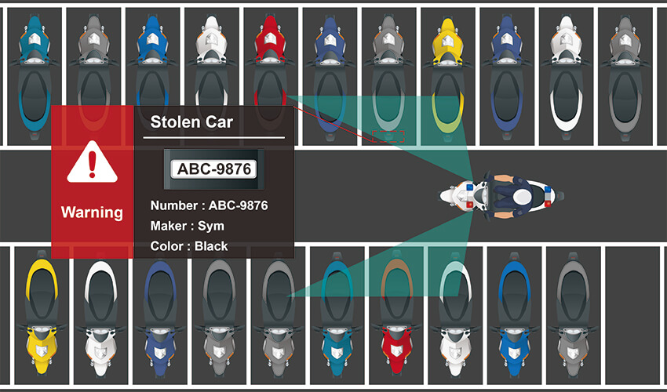
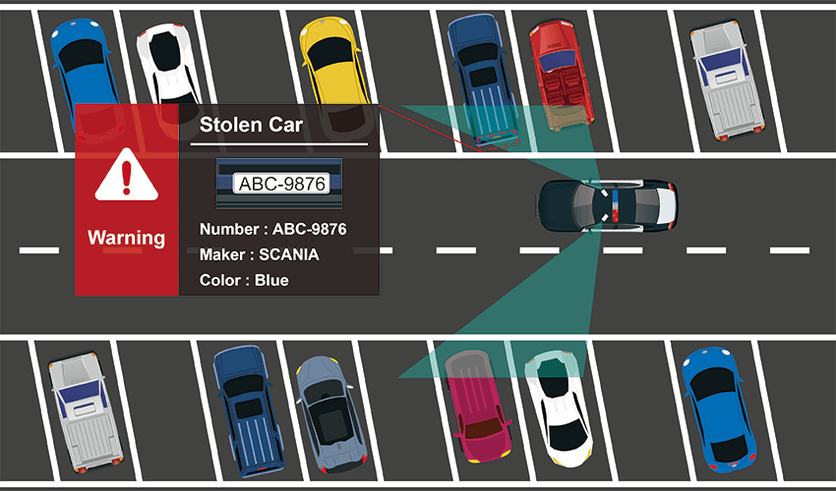
Application in parking lots recognition
Suitable for vehicle inspection when police cars patrol parking lots.
Deploy dual cameras on a system to recognize vehicles in bilateral parking spaces at the same time.

Slide 20
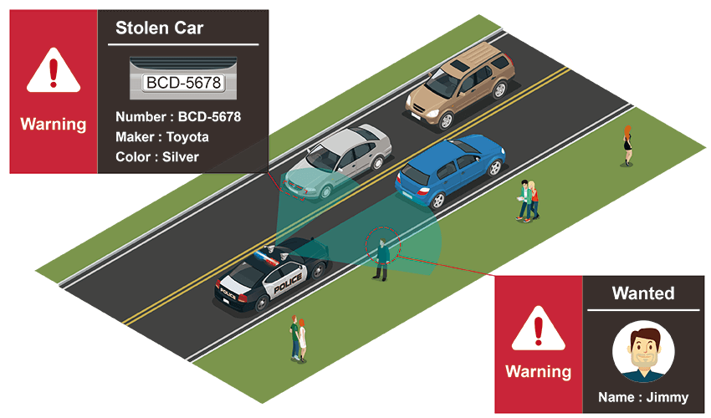
Parked police car recognizes vehicles on the road
When a patrol police car parks on the roadside, the system can identify both the vehicle's license plate number and the pedestrian's face to search for illegal vehicles and wanted criminals or find missing persons.

Slide 21
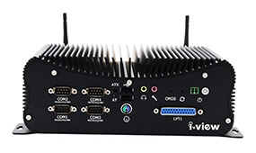
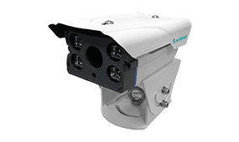
PlateFinder® Related Products
PlateFinder® Mobile ALPR Server
Face recognition cameras (mobile)

Slide 22
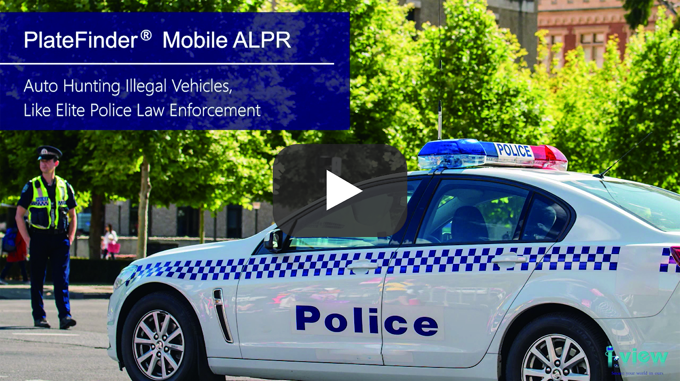
Mobile ALPR system use for on-duty police cars
(Request connect to Interment)

Slide 23
Q & A
I-View Communication Inc.
www.i-view.com.tw
23

